Slide 1
BIG DATA CONCEPTS
Serkan ÖZAL
Middle East Technical University Ankara/TURKEY
October 2013

Slide 2

Contents
Big Data and Scalability
NoSQL
Column Stores
Key-Value Stores
Document Stores
Graph Database Systems
Batch Data Processing
MapReduce
Hadoop
Running Analytical Queries over Offline Big Data
Hive
Pig
RealTime Data Processing
Storm

Slide 3
Big Data
Collect.
Store.
Organize.
Analyze.
Share.
Data growth outruns the ability to manage it so we need scalable solutions.

Slide 4
Scalability - Vertical
Increasing server capacity.
Adding more CPU, RAM.
Managing is hard.
Possible down times

Slide 5
Scalability - Horizontal
Adding servers to existing system with little effort, aka Elastically scalable.
Bugs, hardware errors, things fail all the time.
It should become cheaper. Cost efficiency.
Shared nothing.
Use of commodity/cheap hardware.
Heterogeneous systems.
Controlled Concurrency (avoid locks).
Service Oriented Architecture. Local states.
Decentralized to reduce bottlenecks.
Avoid Single point of failures.
Asynchrony.
Symmetry, you don’t have to know what is happening. All nodes should be symmetric.

Slide 6
NoSQL
Stands for Not Only SQL
Class of non-relational data storage systems
Usually do not require a fixed table schema nor do they use the concept of joins
Offers BASE properties instead of ACID (Atomicity, Consistency, Isolation, Durability) properties
BAsically available: Nodes in the a distributed environment can go down, but the whole system shouldn’t be affected.
Soft State (scalable): The state of the system and data changes over time.
Eventual Consistency: Given enough time, data will be consistent across the distributed system.

Slide 7
What is Wrong With RDBMS?
One size fits all? Not really.
Rigid schema design.
Harder to scale.
Replication.
Joins across multiple nodes? Hard.
How does RDMS handle data growth? Hard.

Slide 8
Advantages & Disadvantages
Advantages
Flexible schema
Quicker/cheaper to set up
Massive scalability
Evantual consistency → higher performance & availability
Disadvantages
No declarative query language → more programming
Evantual consistency → fewer guarantees

Slide 9
NoSQL Systems
Several incarnations
Column Stores
Key-Value Stores
Document Stores
Graph Databases

Slide 10
Column Stores
Each storage block contains data from only one column
More efficient than row (or document) store if:
Multiple row/record/documents are inserted at the same time so updates of column blocks can be aggregated
Retrievals access only some of the columns in a row/record/document
Example Systems
HBase

Slide 11
Key-Value Stores
Extremely simple interface
Data model: (key, value) pairs
Operations:
Insert(key,value), Fetch(key),Update(key), Delete(key)
Implementation: efficiency, scalability, fault-tolerance
Records distributed to nodes based on key
Replication
Single-record transactions, “eventual consistency”
Example systems
Google BigTable, Amazon Dynamo, Cassandra, Voldemort, …

Slide 12
Document Stores
Like Key-Value Stores except value is document
Data model: (key, document) pairs
Document: JSON, XML, other semistructured formats
Basic operations:
Insert(key,document), Fetch(key),Update(key), Delete(key)
Also Fetch based on document contents
Example systems
CouchDB, MongoDB, SimpleDB, …

Slide 13
Graph Database Systems
A graph is a collection nodes (things) and edges (relationships) that connect pairs of nodes.
Attach properties (key-value pairs) on nodes and relationships
Relationships connect two nodes and both nodes and relationships can hold an arbitrary amount of key-value pairs.
A graph database can be thought of as a key-value store, with full support for relationships.
Example systems
Neo4j, FlockDB, Pregel, …

Slide 14
Batch Data Processing
Batch data processing is an efficient way of processing high volumes of data is where a group of transactions is collected over a period of time.
Data is collected, entered, processed and then the batch results are produced
Data is processed by worker nodes and managed by master node.
Analytical queries can be executed as distributed on offline big data. User queries are converted to Map-Reduce jobs on cluster to process big data.
Hive: Supports SQL like query language
Pig: More likely a scripting language

Slide 15
Map-Reduce
MapReduce is a programming model and software framework first developed by Google (Google’s MapReduce paper was submitted in 2004)
A method for distributing a task across multiple nodes
Each node processes data assigned to that node
Consists of two developer-created phases
Map
Reduce
Nice features of MapReduce systems include:
reliably processing a job even when machines die
paralellization on thousands of machines

Slide 16
Map
"Map" step: The master node takes the input, divides it into smaller sub-problems, and distributes them to worker nodes. A worker node may do this again in turn, leading to a multi-level tree structure. The worker node processes the smaller problem, and passes the answer back to its master node.
function map(String name, String document): // name: document name // document: document contents for each word w in document: emit (w, 1) // emit(key, value)

Slide 17
Reduce
"Reduce" step: After map step, the master node collects the answers of all the sub-problems and classifies all values with their keys. Each unique key and its values are sent to a distinct reducer. This means that each reducer processes a distinct key and ita values independently from each other.
function reduce(String word, Iterator partialCounts): // word: a word // partialCounts: a list of aggregated partial counts sum = 0 for each pc in partialCounts: sum += ParseInt(pc) emit (word, sum)

Slide 18
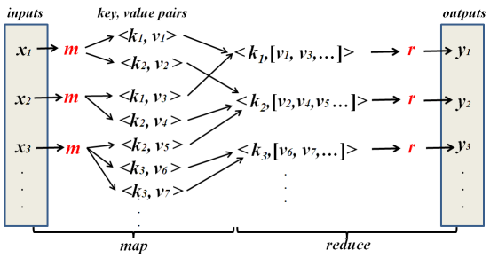
Map-Reduce Overview

Slide 19
Hadoop
Hadoop is a scalable fault-tolerant distributed system for data storage and processing.
Core Hadoop has two main components:
(1) HDFS: Hadoop Distributed File System is a reliable, self-healing, redundant, high-bandwidth, distributed file system optimized for large files.
(2) MapReduce: Fault-tolerant distributed processing
Operates on unsuctured and structured data
Open source under the friendly Apache License

Slide 20
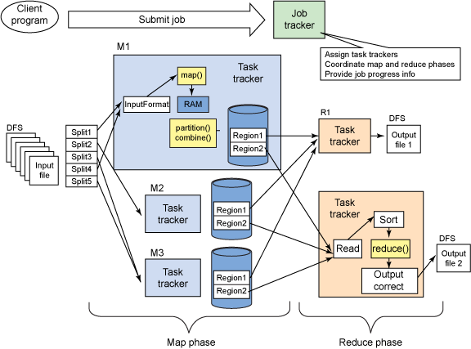
Hadoop Architecture
Notes:
A user runs a client program on a client computer
The client program submits a job to Hadoop
The job is sent to the JobTracker process on the Master Node
Each Slave Node runs a process called the TaskTracker
The job tracker instructs TaskTrackers to run and monitor tasks
A task attempt is an instance of a task running on a slave node
Each Mapper processes single input split from HDFS
Hadoop passes developer’s Map code one record at a time
Each record has a key and a value
Intermediate data is written by the Mapper to local disk
During shuffle and sort phase, all values associated with the same intermediate key are transferred to the same Reducer
Reducer is passed each key and a list of all values
Output from Reducers is written to HDFS

Slide 21
HDFS
Inspired by Google File System
Scalable, distributed, portable file system written in Java for Hadoop framework
Primary distributed storage used by Hadoop applications
HDFS can be part of a Hadoop cluster or can be a stand-alone general purpose distributed file system
An HDFS cluster primarily consists of
NameNode that manages file system metadata
DataNode that stores actual data
Stores very large files in blocks across machines in a large cluster
Reliability and fault tolerance ensured by replicating data across multiple hosts

Slide 22
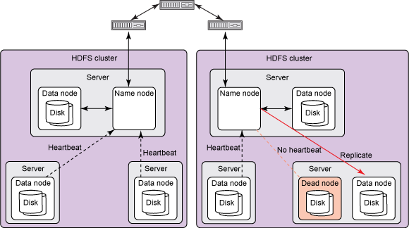
HDFS Architecture

Slide 23
Running Analytical Queries over Offline Big Data
Hadoop is great for large-data processing!
But writing Java programs for everything is verbose and slow
Not everyone wants to (or can) write Java code
Solution: develop higher-level data processing languages
Hive: HQL is like SQL
Pig: Pig Latin is a bit like Perl

Slide 24
Hive
A system for querying and managing structured data built on top of Hadoop
Uses Map-Reduce for execution
HDFS for storage – but any system that implements Hadoop FS API
Key Building Principles:
Structured data with rich data types (structs, lists and maps)
Directly query data from different formats (text/binary) and file formats (Flat/Sequence)
SQL as a familiar programming tool and for standard analytics
Allow embedded scripts for extensibility and for non standard applications
Rich MetaData to allow data discovery and for optimization

Slide 25
Hive - Example
SELECT foo FROM sample WHERE ds='2012-02-24';
INSERT OVERWRITE DIRECTORY '/tmp/hdfs_out' SELECT * FROM sample WHERE ds='2012-02-24';
INSERT OVERWRITE LOCAL DIRECTORY '/tmp/hive-sample-out' SELECT * FROM sample;
Create HDFS dir for the output
Create local dir for the output
SELECT MAX(foo) FROM sample;
SELECT ds, COUNT(*), SUM(foo) FROM sample GROUP BY ds;
FROM sample s INSERT OVERWRITE TABLE bar SELECT s.bar, count(*) WHERE s.foo > 0 GROUP BY s.bar;
Hive allows the From clause to come first !!!
Store the results into a table
25

Slide 26
Pig
A platform for analyzing large data sets that consists of a high-level language for expressing data analysis programs.
Compiles down to MapReduce jobs
Developed by Yahoo!
Open-source language
Common design patterns as key words (joins, distinct, counts)
Data flow analysis
A script can map to multiple map-reduce jobs
Can be interactive mode
Issue commands and get results

Slide 27
Pig - Example
Read file from HDFS
The input format (text, tab delimited)
Define run-time schema
raw = LOAD 'excite.log' USING PigStorage('\t') AS (user, id, time, query);
clean1 = FILTER raw BY id > 20 AND id < 100;
clean2 = FOREACH clean1 GENERATE
user, time,
org.apache.pig.tutorial.sanitze(query) as query;
user_groups = GROUP clean2 BY (user, query);
user_query_counts = FOREACH user_groups
GENERATE group, COUNT(clean2), MIN(clean2.time), MAX(clean2.time);
STORE user_query_counts INTO 'uq_counts.csv' USING PigStorage(',');
Filter the rows on predicates
For each row, do some transformation
Grouping of records
Compute aggregation for each group
Store the output in a file
Text, Comma delimited
27

Slide 28
RealTime Data Processing
In contrast, real time data processing involves a continual input, process and output of data.
Size of data is not certain at the beginning of the processing.
Data must be processed in a small time period (or near real time).
Storm is a most popular open source implementation of realtime data processing.
Most importantly used by Twitter.

Slide 29
Storm
Is a highly distributed realtime computation system.
Provides general primitives to do realtime computation.
Can be used with any programming language.
It's scalable and fault-tolerant.

Slide 30
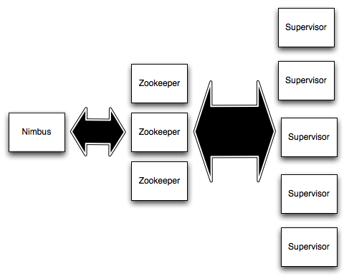
Architecture – General Overview

Slide 31
Architecture - Components
Nimbus
Master node (similar to Hadoop JobTracker)
Responsible for distributing code around the cluster, assigning tasks to machines, and monitoring for failures.
ZooKeeper
Used for cluster coordination between Nimbus and Supervisors.
Nimbus and Supervisors are fail-fast and stateless; all state is kept in Zookeeper or on local disk.
Supervisor
Run worker processes.
The supervisor listens for work assigned to its machine and starts and stops worker processes as necessary based on what Nimbus has assigned to it.

Slide 32
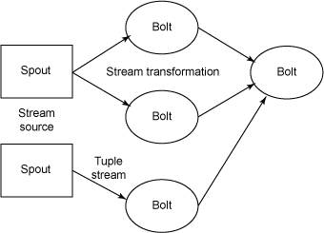
Main Concepts – General Overview

Slide 33
Main Concepts - Components
Streams
Unbounded sequence of tuples/datas (input or output)
Spouts
Source of streams
Such as reading data from Twitter streaming API
Bolts
Processes input streams, does some processing and possibly emits new streams
Topologies
Network of spouts and bolts

Slide 34

Thanks for Listening

